Slide 1
Division of Research, Innovation & Ventures (DRIVe) Acquisitions Team
Matthew McCord
Head of Partnering / Chief Contracting Officer
DRIVe Acquisition Team
Division of Contract Management & Acquisitions (CMA)

Slide 2


DRIVe Acquisitions Team: EZ-BAA 2.0
BARDA DRIVe EZ-BAA Abstract Review Process
Market Research Call with DRIVe AOI PM
Streamlined broad agency announcement (“BAA”)
Simplified application process
Projects under $750,000
Abstract to Award = 30 to 120 Days
Abstract Submission
Award
Successful Negotiation
Acceptable
Initial Abstract Review
Proposal Evaluation
Interested
Submission of SOW
Cost & Technical Information
Not Interested
Not Accepted
Respondent Notified
Respondent Notified
Notes:
Don’t say “hopefully” this will make it easier. It WILL make it easier.

Slide 3


DRIVe Acquisitions Team: The EZ-BAA & COVID-19 Response
EZ-BAA
FEB 2020
500+
36
9
EZ-BAA 2.0 Released
(BAA-20-100-SOL-0002)
Submissions Received
Contracts Executed
Fewest Number of Days from Abstract to Award
Notes:
Don’t say “hopefully” this will make it easier. It WILL make it easier.

Slide 4

DRIVe Acquisitions Team: Aligning Interests
Every DRIVe contract has included a cost-share element

Slide 5

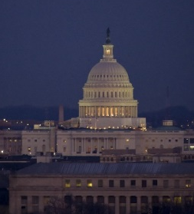

DRIVe Acquisitions Team: BARDA Ventures
‘21st Century Cures Act’ authorized BARDA to utilize “strategic venture capital practices and methods […]”
(see (P.L. 114-255))
Extensive Market Research
&
Requirement Development
Next Steps: Fiscal Year 2021

